Slide 1
Bus Boys
Database System Term Project
Created by
Terence Bush

Slide 2
Topic practicality
This project has us in the role of a bus station overseer
The database lists:
The bus companies and their busses running
The bus stations and their locations
Some of the employees at the various locations
The customers and their identifications

Slide 3
Specifications
Minimum of seven tables
Minimum of three Foreign key (FK)
Minimum of ten tuples in each table

Slide 4
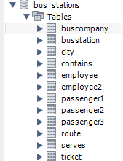
Tables

Slide 5
Ten tuples
Will be featured in the following screenshots along with tables

Slide 6
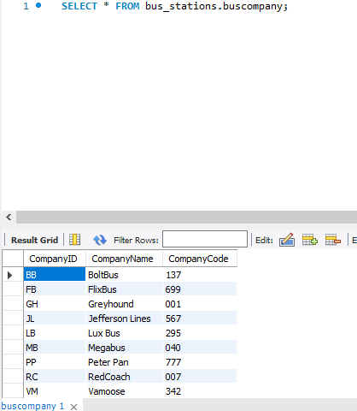
Table 1: Bus Company
Companies
Bolt Bus
Flixbus
Greyhound
Jefferson Lines
Lux Bus
Megabus
Peter Pan
RedCoach
Tripper Bus
Vamoose

Slide 7
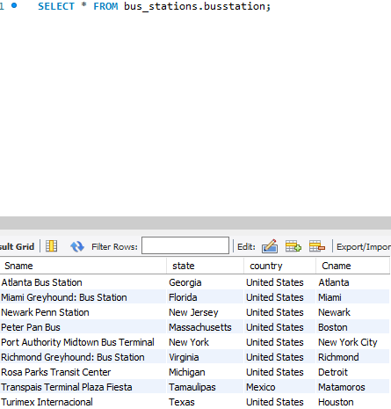
Table2: Bus Stations
Atlanta Bus Station
Miami Greyhound: Bus Station
Newark Penn Station
Peter Pan Bus
Port Authority Midtown Bus Terminal
Richmond Greyhound: Bus Station
Rosa Parks Transit Center
Transpais Terminal Plaza Fiesta
Turimex Internacional
Union Station

Slide 8
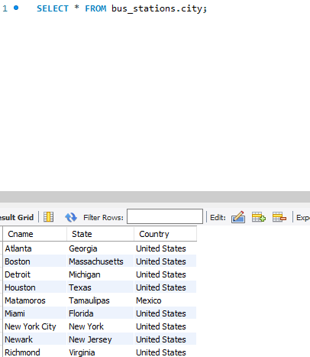
Table3: City
Atlanta
Boston
Detroit
Houston
Matamoros
Miami
New York City
Newark
Richmond
Toronto

Slide 9
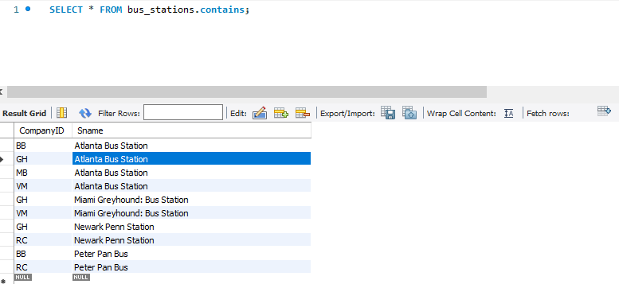
Table4: Contains
BB Atlanta Bus Station
GH Atlanta Bus Station
MB Atlanta Bus Station
VM Atlanta Bus Station
GH Miami Greyhound: Bus Station
VM Miami Greyhound: Bus Station
GH Newark Penn Station
RC Newark Penn Station
BB Peter Pan Bus
RC Peter Pan Bus

Slide 10
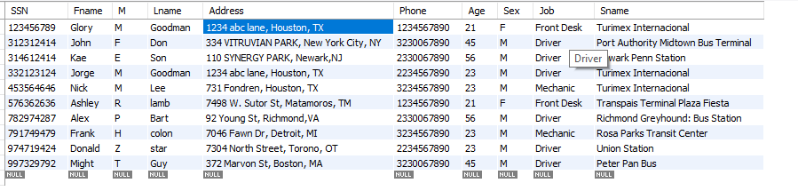
Table 5: Employees

Slide 11
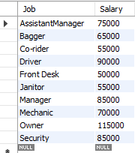
Table 6: Employee2

Slide 12
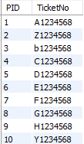
Table7:Customer
PID (personal ID)
Ticket number

Slide 13
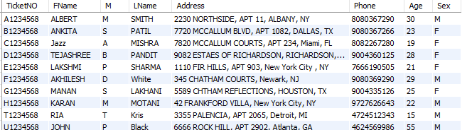
Table8: Customer2

Slide 14
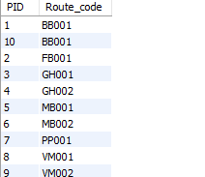
Table9: Customer3

Slide 15
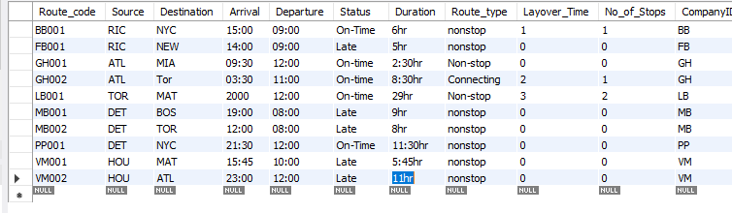
Table10: Routes

Slide 16
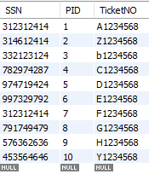
Table11: Serves
Driver By SSN
PID for Passenger
Ticket Number for passenger

Slide 17
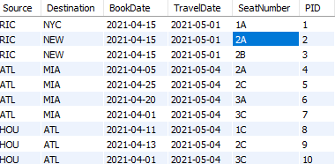
Table12: Ticket

Slide 18
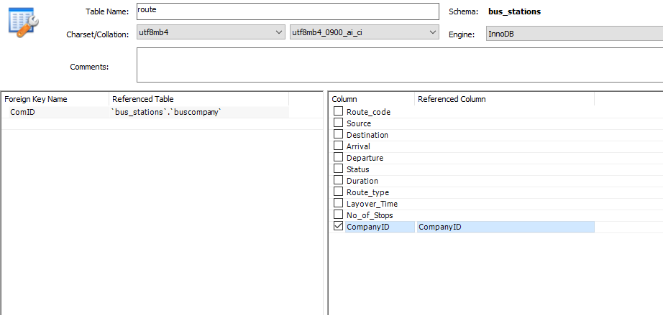
Foreign key 1

Slide 19
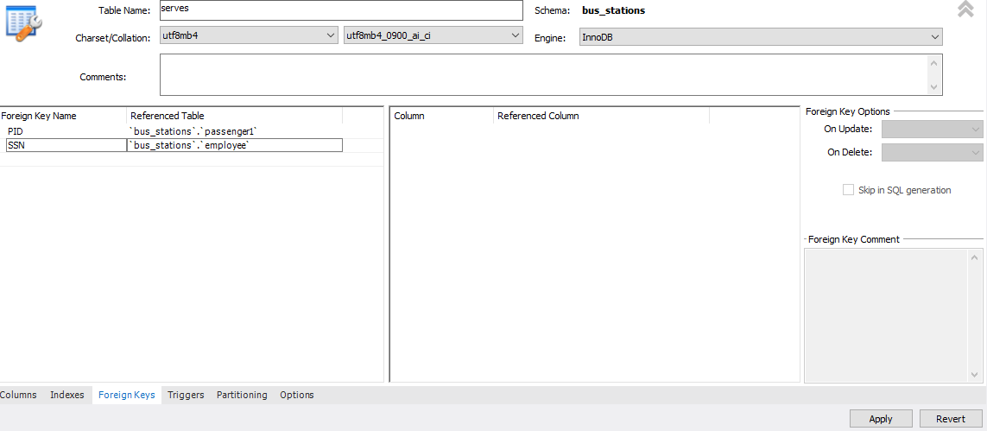
Foreign key 2 & 3

Slide 20
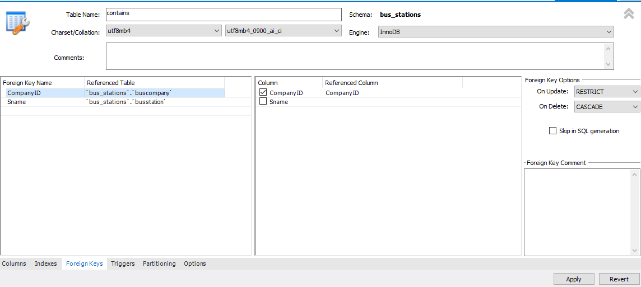
Foreign Key 4 & 5

Slide 21
Fin

